Slide 1
Setup
Managed Switches

Slide 2



Testbed
Linux machine
10G Port
M4350
M4350
10G or 1G Port
10G or 1G Port
10G or 1G Port
M4250
M4250
1G connection
1G connection
Linux machine
Windows

Slide 3
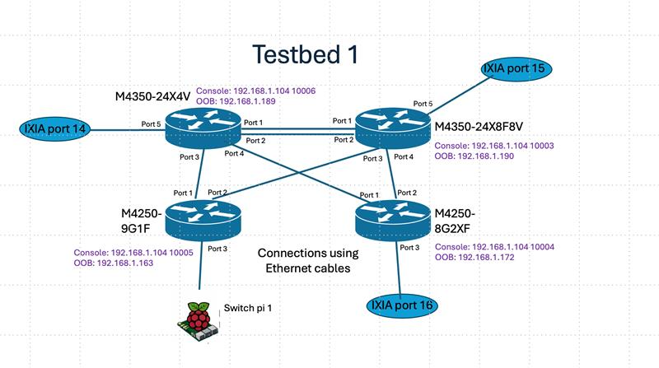

Slide 4
All interconnects in the diagram are of traffic ports only.
Same speed links between M4250 and M4350 to be used. (Can be 1G or 10G but same speed and same media type)
Ports can be copper of fiber depending availability of the type of Managed switch that satisfies point 2 above.
Need Telnet/SSH access for all switches thru management port.
Suggestion: All management ports can be connected to a smart switch and then smart switch connected to a Laptop with Team viewer. Any other way is also fine.
Console access (wherever possible)

Slide 5
By enabling/disabling the inter-connections, the setup can be customized for the following tests.
PTP (With PCAP injection)
IGMP
Spanning tree
Routing protocols
Stacking
MLAG

